Slide 1
607 Final Project
AGENDA
DAVID APOLINAR
CHRISTINA VALORE
ANTHONY MUÑOZ
MTA Ridership Delays
Possible MTA Delay causes
Data Collection
Data Analysis
Conclusion

Slide 2
Problem Statement
The MTA experiences continuous delays each year
What are the possible causes?
Equipment Issues
Weather
Population
Broken Trains
How much does weather contribute to delays?

Slide 3


OBTAINING OUR DATA
DATA SOURCES
WEB SOURCES
MTA SOURCES
DATA STORAGE
Mta.org
Weather.gov
Limited to temperatures due to cost for additional data
worldpopulationreview.com
On-Time Performance
Subway Wait Assessment
Total Ridership
GitHub Repos
MongoDB
Azure Blob Storage
Notes:
TODO: Another challenge (how to make others great and leverage the work of others). Discuss impact through others. Shed hero culture and help elevate others. Stop. Start. Continue.
Answer: What is the thing that will prevent me from being successful

Slide 4



SCRUBBING
CLEANING OUR DATA
TIDAVERSE
DPLYR
RVEST
DATA BRICKS
APIS
Wide to Long Transformations
Filtering
Web Scraping and Parsing
Mangling Big Data
Aggregation
Connecting to MongoDB
Connecting to Data Bricks
Notes:
TODO: Another challenge (how to make others great and leverage the work of others). Discuss impact through others. Shed hero culture and help elevate others. Stop. Start. Continue.
Answer: What is the thing that will prevent me from being successful

Slide 5

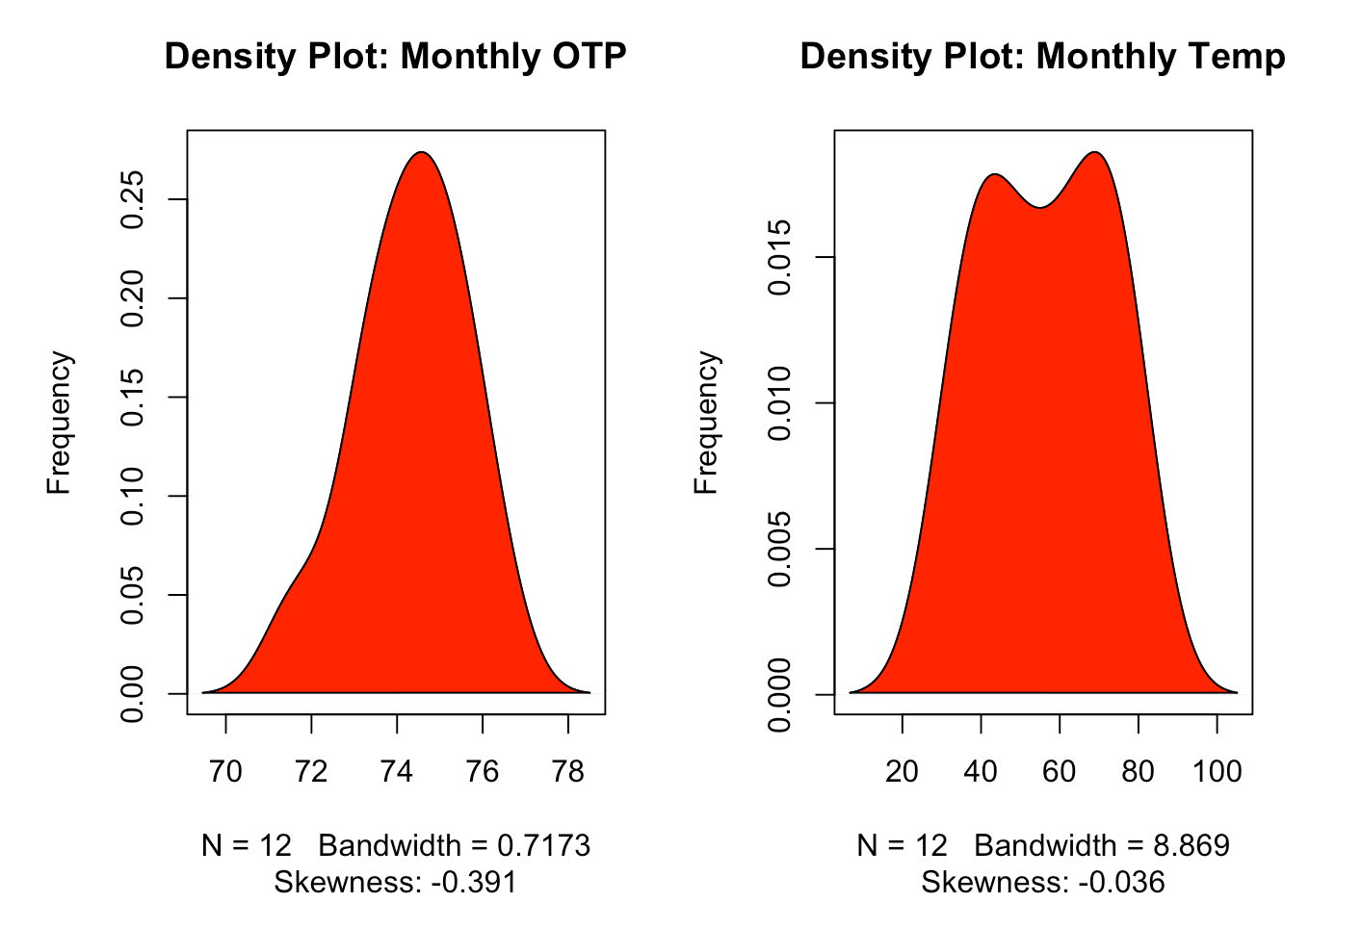
EXPLORING
VISUALIZING OUR DATA TO FIND PATTERNS AND TRENDS
DENSITY PLOT
TALKING POINTS
ARE THERE ANY PATTERNS NOTICED
Notes:
TODO: Do some research (Stephani T, Nik) on the capabilities on the Chief Architect (distinguished from the Architect)
Talk Track: What I have been doing and what I believe Chief Architect should be, but I didn’t wait for the title

Slide 6
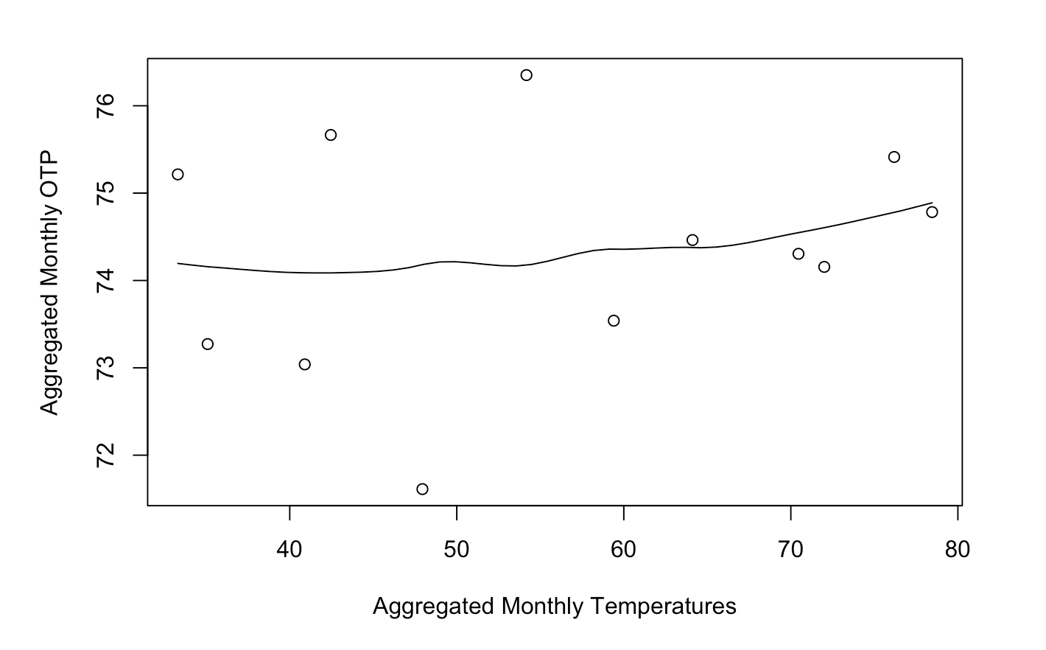
MODELING
MODELING OUR DATA WILL GIVE US OUR PREDICTIVE POWER AS A WIZARD
SCATTER PLOT
SLIGHT POSITIVE TREND
SEVERAL OUTLINERS MAKE A LINEAR MODEL DIFFICULT
SEVERAL POINTS MORE CLOSER AT HIGHER TEMPERATURES

Slide 7
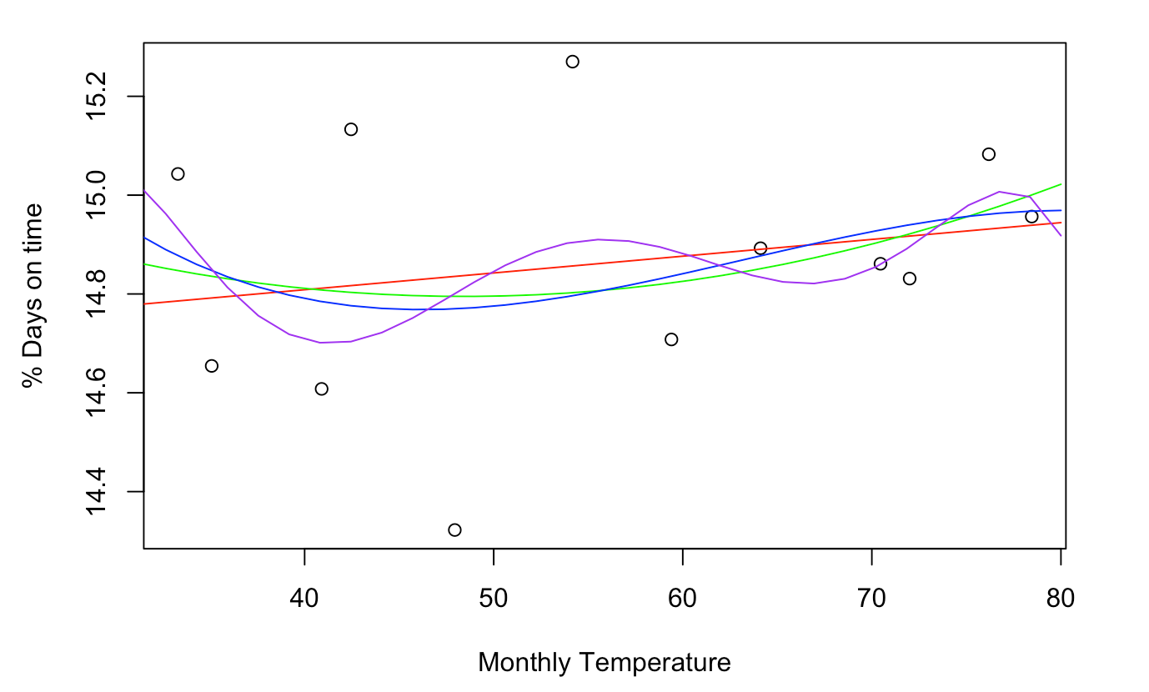
INTERPRETATION
INTERPRETING OUR DATA
POLYNOMIAL MODEL
BEST POSSIBLE FIT
R2 ACCOUNTS FOR ONLY 12% OF THE VARIABLITY
WEATHER IS NOT A GOOD PREDICTOR OF TRAIN DELAYS

Slide 8
CONCLUSION
DID WE LEARN ANYTHING NEW?
Predicting MTA delays is incredibility challenging
Several other data features could help contribute to prediction
Length between Signal repairs
Weather is not a major factor when determining delays

Slide 9
FEEDBACK
Q&A

